Slide 1
Chapter 12: Programming Schedulable Systems

Slide 2
Aims
To briefly show how cyclic executives are implemented
To illustrate how Ada, C/Real-Time POSIX and Real-Time Java support priority based dispatching
To show how all the above define subsets specifically focused on predicable real-time performance
To illustrate how Ada supports EDF and mixed scheduling behaviour

Slide 3
Cyclic Executive
Requires a very simple run-time, with
  Regular timing interrupt
  Table of procedures to call

Slide 4
Consider Task Set
Task Period,T Computation Time,C
a 25 10
b 25 8
c 50 5
d 50 4
e 100 2

Slide 5
Time-line for Task Set
Interrupt
Interrupt
Interrupt
Interrupt
a
b
c
a
b
d
e
a
b
c

Slide 6
Cyclic Executive
loop
wait_for_interrupt;
procedure_for_a; procedure_for_b; procedure_for_c;
wait_for_interrupt;
procedure_for_a; procedure_for_b; procedure_for_d;
procedure_for_e;
wait_for_interrupt;
procedure_for_a; procedure_for_b; procedure_for_c;
wait_for_interrupt;
procedure_for_a; procedure_for_b; procedure_for_d;
end loop;

Slide 7
Priority-based Systems
Supported by Ada and Real-Time Java
Supported by most commercial RTOSs
Supported by POSIX
Usually preemptive
Needs a reasonable range of priorities
Needs some form of priority inheritance

Slide 8
Ada: Real-Time Annex
Ada has a flexible model:
  base and active priorities
  priority ceiling locking
  various dispatching policies using active priority
  Profiles – including Ravenscar Profile
  dynamic priorities and ceilings
Pragma Task_Dispatching_Policy(FIFO_Within_Priorities)

Slide 9
Ada: Real-Time Annex
subtype Any_Priority is Integer
range Implementation-Defined;
subtype Priority is Any_Priority range
Any_Priority'First .. Implementation-Defined;
subtype Interrupt_Priority is Any_Priority range
Priority'Last + 1 .. Any_Priority'Last;
Default_Priority : constant Priority :=
(Priority'First + Priority'Last)/2;
An implementation must support a range of Priority of at least 30 and at least one distinct Interrupt_Priority

Slide 10
Assigning Base Priorities
Using the pragma
task Controller is
pragma Priority(10);
end Controller;
task type Servers(Pri : System.Priority) is
-- each instance of the task can have a
-- different priority
entry Service1(...);
entry Service2(...);
pragma Priority(Pri);
end Servers;

Slide 11
Priority Ceiling Locking
Protected objects need to maintain the consistency of their data
Mutual exclusion can be guaranteed by use of the priority model
Each protected object is assigned a ceiling priority which is greater than or equal to the highest priority of any of its calling tasks
When a task calls a protected operation, its priority is immediately raised to that of the protected object
If a task wishing to enter a protected operation is running then the protected object cannot be already occupied (on a single processor)

Slide 12
Ceiling Locking
Each protected object is assigned a priority using a pragma
If the pragma is missing, Priority'Last is assumed
Program_Error is raised if the calling task's active priority is greater than the ceiling
If an interrupt handler is attached to a protected operation and the wrong ceiling priority has been set, then the program becomes erroneous
With ceiling locking, an effective implementation will use the thread of the calling task to execute not only the protected operation but also to execute the code of any other tasks that are released as a result of the call

Slide 13
Example of Ceiling Priority
protected Gate_Control is
pragma Priority(28);
entry Stop_And_Close;
procedure Open;
private
Gate : Boolean := False;
end Gate_Control;
protected body Gate_Control is
entry Stop_And_Close
when Gate is
begin
Gate := False;
end;
procedure Open is
begin
Gate := True;
end;
end Gate_Control;

Slide 14
Example
Assume task T, priority 20, calls Stop_And_Close and is blocked. Later task S, priority 27, calls Open. The thread executing S will undertake the following operations:
  the code of Open for S
  evaluate the barrier on the entry and note that T can now proceed
  the code Stop_And_Close for T
  evaluate the barrier again
  continue with the execution of S after its call on the protected object
There is no context switch

Slide 15
Active Priorities
A task entering a protected operation has its priority raised
A task’s active priority might also change during:
  task activation ⎯ a task inherits the active priority of the parent task which created it (to avoid priority inversion)
  during a rendezvous ⎯ the task executing a rendezvous will inherit the active priority of the caller if it is greater than its current active priority
  Note: no inheritance when waiting for task termination

Slide 16
Dispatching
The order of dispatching is determined by the tasks' active priorities
Default is preemptive priority based
  Programmer can use pragma Task_Dispatching_Policy to specify required policy
Not defined exactly what this means on a multi-processor system
One policy defined by annex: FIFO_Within_Priority
When a task becomes runnable it is placed at the back on the run queue for its priority; when it is preempted, it is placed at the front

Slide 17
Ravenscar
Ada allows profiles (subsets) of language features to be specified
One such is the Ravenscar profile aimed at predictable real-time performance
Subset of Tasking features
Resulting in a simple run-time
Amenable to the analysis presented in previous chapter

Slide 18
Ravenscar allows
Task types and objects at library level (only)
Protected types and objects at library level (only)
One entry per PO – and at most one task queued
Entry barriers in POs restricted to a single boolean variable
delay until statements
FIFO_Within_Priority and Ceiling_Locking
Protected procedures as interrupt handlers
A number of other more minor features

Slide 19
Ravenscar does not allow
Select statements of any form (eg no ATCs)
Delay statements
Task hierarchies
Task termination – ie all tasks are assumed to run for the entire life of the system
Requeue statements
Asynchronous task control
and a number of other features

Slide 20
Ravenscar
Defined by the use of the Restrictions pragma
This can define features that are not used by the program
  The compile can check
Includes No_Dependencies to highlight that named packages are not to be included

Slide 21
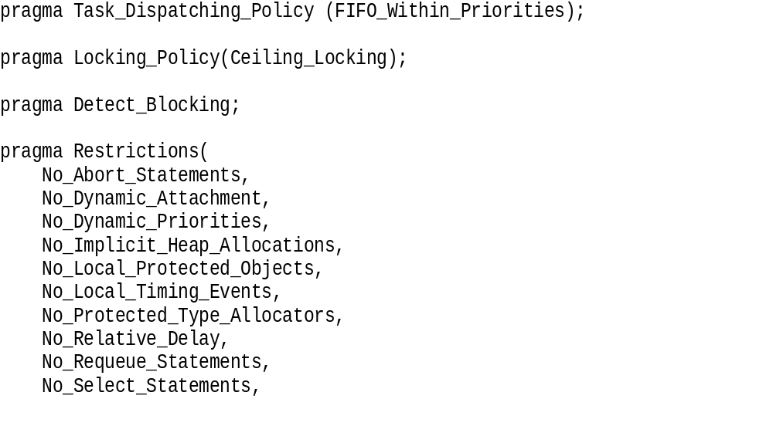
Ravenscar Definition

Slide 22
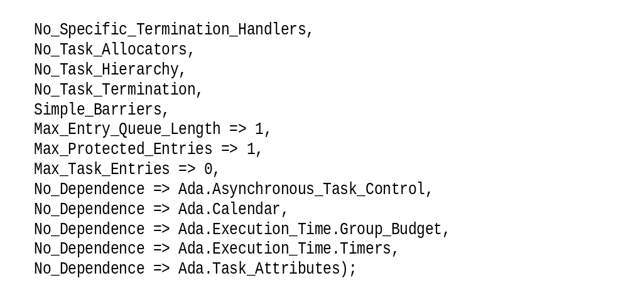
Ravenscar Definition

Slide 23
Dynamic Priorities
Some applications require the base priority of a task to change dynamically: e.g., mode changes, or to implement dynamic scheduling scheme
Ada allows tasks to change their base priorities and protected objects and to change their ceiling priorities.

Slide 24
Package Specification
with Ada.Task_Identification; use Ada;
package Ada.Dynamic_Priorities is
procedure Set_Priority(Priority : System.Any_Priority;
T : Task_Identification.Task_Id :=
Task_Identification.Current_Task);
function Get_Priority(T : T_Identification.Task_Id
:= Task_Identification.Current_Task)
return System.Any_Priority;
-- raise Tasking_Error if task has terminated
-- Both raise Program_Error if a Null_Task_Id is passed
private
-- not specified by the language
end Ada.Dynamic_Priorities;

Slide 25
Dynamic Priorities
The effect of a change of base priorities should be as soon as practical but not during an abort deferred operation and no later than the next abort completion point
Changing a task's base priority can affect its active priority and have an impact on dispatching and queuing

Slide 26
Dynamic Ceiling Priorities
Ada supports dynamic ceiling for protected objects, by assignment to the attribute ‘Priority
Assignment only allowed from within the protected object
The chance to the ceiling value only occurs at the end of the protected operation – Why?

Slide 27
(A)Synchronous Task Control
Ada allows a task to suspend itself or other tasks
  Synchronous task control
  Asynchronous task control

Slide 28
Asynchronous Definition
with Ada.Task_Identification;
package Ada.Asynchronous_Task_Control is
procedure Hold(T : Task_Identification.Task_Id);
procedure Continue(T : Task_Identification.Task_Id);
function Is_Held(T : Task_Identification.Task_Id)
return Boolean;
end Ada.Asynchronous_Task_Control;

Slide 29
Entry Queue Policies
A programmer may choose the queuing policy for a task's entry queue and the select statement
Two predefined policies: FIFO_Queuing (default) and Priority_Queuing
With Priority_Queuing and the select statement, an alternative that is open and has the highest priority task queued (of all open alternatives) is chosen
If there are two open with equal priority tasks, the one which appears textually first in the program is chosen
Tasks are queued in active priority order, if active priority changes then no requeuing takes place; if the base priority changes, the task is removed and requeued

Slide 30
POSIX
POSIX supports priority-based scheduling, and has options to support priority inheritance and ceiling protocols
It defines four profiles to subset its facilities
Priorities may be set dynamically

Slide 31
POSIX Profiles
PSE51 – minimal real-time profile
  Threads, fixed pri scheduling, mutexes with priority inheritance, condition variable, semaphores, signals and simple I/O – analogous to Ravenscar
PSE52 – real-time control profile
  Mulitprocesors, file system, message queues, tracing
PSE53 – dedicated real-time profile
  Multithreaded processes, asynchronous I/O
PSE54 – multipurpose real-time systems profile
  Real-time and non real-time, memory management, networks etc

Slide 32
POSIX Policies
Within the priority-based facilities, there are four policies:
  FIFO: a process/thread runs until it completes or it is blocked
  Round-Robin: a process/thread runs until it completes or it is blocked or its time quantum has expired
  Sporadic Server: a process/thread runs as a sporadic server
  OTHER: an implementation-defined

Slide 33
POSIX Priorities
For each policy, there is a minimum range of priorities that must be supported; 32 for FIFO and round-robin
The scheduling policy can be set on a per process and a per thread basis

Slide 34
POSIX Priorities
Threads may be created with a system contention option, in which case they compete with other system threads according to their policy and priority
Alternatively, threads can be created with a process contention option where they must compete with other threads (created with a process contention) in the parent process
  It is unspecified how such threads are scheduled relative to threads in other processes or to threads with global contention
A specific implementation must decide which to support

Slide 35
Sporadic Server in POSIX
A sporadic server assigns a limited amount of CPU capacity to handle events, has a replenishment period, a budget, and two priorities
The server runs at a high priority when it has some budget left and a low one when its budget is exhausted
When a server runs at the high priority, the amount of execution time it consumes is subtracted from its budget
The amount of budget consumed is replenished at the time the server was activated plus the replenishment period
When its budget reaches zero, the server's priority is set to the low value

Slide 36
Other Facilities
POSIX allows:
priority inheritance to be associated with mutexes (priority protected protocol= ICPP)
message queues to be priority ordered
functions for dynamically getting and setting a thread's priority
threads to indicate whether their attributes should be inherited by any child thread they create

Slide 37
Real-Time Java
Introduces the notion of a schedulable object rather than considering just threads
A schedulable object is any object which implements the Schedulable interface
Scheduling parameters are represented by a class
Enables online as well as static priority based scheduling
Implementations are required to support at least 28 real-time priority levels

Slide 38
Real-Time Java
As with Ada and POSIX, the larger the integer value, the higher the priority
Non real-time threads are given priority levels below the minimum real-time priority
Like Ada and Real-Time POSIX, RTSJ supports a pre-emptive priority-based dispatching policy
Unlike Ada and RT POSIX, RTSJ does not require a preempted thread to be placed at the head of the run queue associated with its priority level

Slide 39
Schedulable Interface
public interface Schedulable extends java.lang.Runnable {
...
public void addToFeasibility();
public void removeFromFeasibility();
public MemoryParameters getMemoryParameters();
public void setMemoryParameters(MemoryParameters memory);
public ReleaseParameters getReleaseParameters();
public void setReleaseParameters(ReleaseParameters release);
public SchedulingParameters getSchedulingParameters();
public void setSchedulingParameters(
SchedulingParameters scheduling);
public Scheduler getScheduler();
public void setScheduler(Scheduler scheduler);
}

Slide 40
Schedulable Interface
The interface is supported by
  RealtimeThread
  NoHeapRealtimeThread
  AsyncEventHandler
Objects of these classes all have scheduling parameters

Slide 41
Scheduling Parameters
public abstract class SchedulingParameters {
public SchedulingParameters();
}
public class PriorityParameters extends SchedulingParameters {
public PriorityParameters(int priority);
public int getPriority();
public void setPriority(int priority) throws
IllegalArgumentException;
...
}
public class ImportanceParameters extends PriorityParameters {
public ImportanceParameters(int priority, int importance);
public int getImportance();
public void setImportance(int importance);
...
}

Slide 42
Scheduler Class
The scheduler class in define as follows
  It is mainly concerned with online tests

Slide 43
Scheduler Class
public abstract class Scheduler {
protected Scheduler();
protected abstract void addToFeasibility(
Schedulable schedulable);
protected abstract void removeFromFeasibility(
Schedulable schedulable);
public abstract boolean isFeasible();
// checks the current set of schedulable objects
public boolean changeIfFeasible(Schedulable schedulable,
ReleaseParameters release,
MemoryParameters memory);
public static Scheduler getDefaultScheduler();
public static void setDefaultScheduler(Scheduler scheduler);
public abstract java.lang.String getPolicyName();
}

Slide 44
Priority Scheduler
One defined subclass of Scheduler is the PriorityScheduler

Slide 45
Priority Scheduler
class PriorityScheduler extends Scheduler
{
public PriorityScheduler()
protected void addToFeasibility(Schedulable s);
...
public int getMaxPriority();
public int getMinPriority();
public int getNormPriority();
public static PriorityScheduler instance();
...
}
Standard preemptive priority-based scheduling

Slide 46
Other Facilities
Priority inheritance and ICCP (called priority ceiling emulation)
Support for aperiodic threads in the form of processing groups; a group of aperiodic threads can be linked together and assigned characteristics which aid the feasibility analysis

Slide 47
Profiles
Level 0
  Similar to a cyclic executive
Level 1
  Fixed priority scheduling, periodic and sporadic events, mutual exclusion (only)
Level 2
  Asynchronous event handlers and/or NoHeapRealtimethreads,wait and notify

Slide 48
Programming EDF systems
To support EDF scheduling requires:
  A formal representation of a task’s deadline
  Use of task deadlines to control dispatching
  A means of sharing data between tasks that is compatible with EDF
A package is provided that allow deadlines to be set and a task to delay itself with one deadline, but awake with another

Slide 49
EDF Dispatching Package
package Ada.Dispatching.EDF is
subtype Deadline is Ada.Real_Time.Time;
Default_Deadline : constant Deadline :=
Ada.Real_Time.Time_Last;
procedure Set_Deadline(D : in Deadline;
T : in Ada.Task_Identification.Task_ID :=
Ada.Task_Identification.Current_Task);
procedure Delay_Until_And_Set_Deadline(
Delay_Until_Time : in Ada.Real_Time.Time;
TS : in Ada.Real_Time.Time_Span);
function Get_Deadline(T : in Ada.Task_Identification.Task_ID
:= Ada.Task_Identification.Current_Task) return Deadline;
end Ada.Dispatching.EDF;

Slide 50
Specifying EDF
pragma Task_Dispatching_Policy(EDF_Across_Priorities);
A range of priority levels is associated with EDF scheduling
A pragma is available to set the initial deadline for a task – to control
activation
task Periodic_Task is
pragma Relative_Deadline(Milliseconds(30));
end Periodic_Task;

Slide 51
Example Task
task body Periodic_Task is
Interval : Time_Span := Milliseconds(30);
-- define the period of the task, 30ms in this example
-- relative deadline equal to period
Next : Time;
begin
Next := Clock; -- start time
Set_Deadline(Clock+Interval);
loop
-- undertake the work of the task
Next := Next + Interval;
Delay_Until_And_Set_Deadline(Next,Interval);
end loop;
end Periodic_Task;

Slide 52
EDF and Baker’s Algorithm
SRP – Stack Resource Policy – is a generalisation of the priority ceiling protocol
Two notions:
  Preemption level for access to shared objects
  Urgency for access to processor
With FPS, priority is used for both
With EDF, ‘priority’ is used for preemption level, and earliest absolute deadline is used for urgency

Slide 53
Ada’s model
All ready queues are ordered by (absolute) deadline
A range of priorities is reserved for EDF
If no Protected objects are used then ALL tasks enter the ready queue for Priority’First
  ie priority is ignored
If a task enters a PO it will execute with the ceiling priority (as in fixed pri execution)
If task S is current executing in a PO and task T becomes runnable then the following rules apply

Slide 54
Ada’s Rules
If T has a shorted (absolute) deadline and a high priority than S’s current priority (ceiling of PO) then
  T will preeempt S and run with S’s priority
If not then
  T is added to ready queue for Priority’First
Rules work for POs calling POs etc.

Slide 55
Example
Following slide has a simple system of 5 tasks with preemption levels 1..5
Dispatched by:
pragma Task_Dispatching_Policy(FIFO_Within_Priorities);

Slide 56
Example (cont’d)
protected X is – one of 3 POs
pragma Priority(5);
-- Definitions of subprograms.
private
-- Definition of internal data.
end X;
task A is
pragma Priority(5);
end A;

Slide 57
Example (cont’d)
-- period and relative deadline equal to 10ms.
task body A is
Next_Release: Ada.Real_Time.Time;
begin
Next_Release := Ada.Real_Time.Clock;
loop
-- Code, including call(s) to X.
Next_Release := Next_Release + Milliseconds(10);
delay until Next_Release;
end loop;
end A;

Slide 58
Example (cont’d)
task A is
pragma Priority(5);
pragma Relative_Deadline(10);
end A;
pragma Task_Dispatching_Policy(EDF_Across_Priorities);

Slide 59
Example (cont’d)
task body A is
Next_Release: Ada.Real_Time.Time;
begin
Next_Release := Ada.Real_Time.Clock;
loop
-- Code, including call(s) to X.
Next_Release := Next_Release + Milliseconds(10);
Delay_and_Set_Deadline(Next_Release + Milliseconds(10));
delay until Next_Release;
end loop;
end A;

Slide 60
Mixed Dispatching
Ada also allows different dispatching policies to be used together in a controlled and predictable way
Protected object can be used to communicate across policies
pragma Priority_Specific_Dispatching(
policy_identifier,
first_priority_expression,
last_priority_expression);

Slide 61
High Priority
FIFO
FIFO
FIFO
EDF
EDF
EDF
RR
Low Priority

Slide 62
Splitting the Priority Range
pragma Priority_Specific_Dispatching
(Round_Robin_Within_Priority,1,1);
pragma Priority_Specific_Dispatching
(EDF_Across_Priorities,2,10);
pragma Priority_Specific_Dispatching
(FIFO_Within_Priority,11,24);

Slide 63
Summary
Fixed Priority Scheduling is well supported by Ada, C/Real-Time POSIX and Real-Time Java
EDF is less well supported but is available in Ada
The Ada model for EDF fully supports Baker’s algorithm

